Slide 1
Software Engineering Fundamentals: Java
Module : UML
Notes:
Solutions Engineering Fundamentals: Java
Course #Z16325
© 2009 Accenture All Rights Reserved.
Speaker notes:
Note:
This module is from SEF so module details cannot be changed. Retained it as it is. It is Module 17 of SEF Java material

Slide 2
Module Objectives
At the end of this module, participants will be able to:
  Explain the background behind UML and its use in software design and development
  Describe when and how to apply the following diagrams:
    Use Cases
    Class Diagrams
    Sequence Diagrams
    State Diagrams
Notes:
Solutions Engineering Fundamentals: Java
Course #Z16325
© 2009 Accenture All Rights Reserved.

Slide 3
UML
Stands for Unified Modeling Language
A standard language for specifying, visualizing, constructing, and documenting the components of systems
UML is independent of particular programming languages and development processes
Notes:
Solutions Engineering Fundamentals: Java
Course #Z16325
© 2009 Accenture All Rights Reserved.
Commonly applied, but not limited to software systems (such as business modelling)

Slide 4
Use Case Diagrams
Useful in determining initial system requirements and functionalities
Displays relationships and interactions between actors and the systems they act upon
Identifies the ‘actors’ in a system and the various cases that the actors might interact with the system
Notes:
Solutions Engineering Fundamentals: Java
Course #Z16325
© 2009 Accenture All Rights Reserved.
This is a good diagram to start with when determining what a system is supposed to be able to do. Imagine being a user in the system and listing what actions you are able to perform

Slide 5
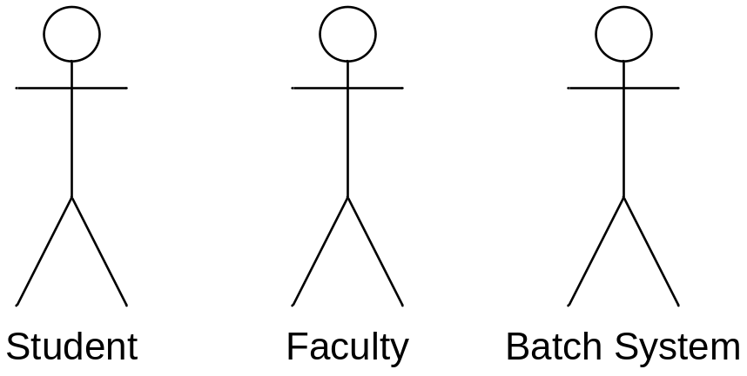
Use Case Diagrams
Actors represent an entity that initiates the interaction with the system
An actor can represent a user, organization, or another external system
Notes:
Solutions Engineering Fundamentals: Java
Course #Z16325
© 2009 Accenture All Rights Reserved.

Slide 6
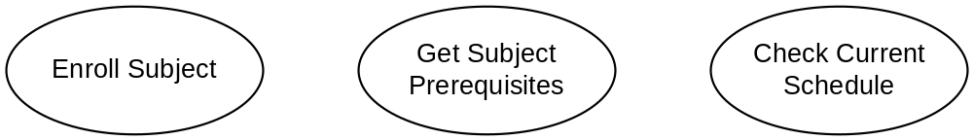
Use Case Diagrams
A ‘use case’ represents a possible interaction between the actor and the system
Each use case is a high level description of a functionality that must be supported by the system
Notes:
Solutions Engineering Fundamentals: Java
Course #Z16325
© 2009 Accenture All Rights Reserved.

Slide 7
Use Case Diagrams
An interaction between an actor and a system is denoted by a line marked by a <<uses>> tag
This can be interpreted as “The (actor) can use the system to <<use case>>”
«uses»
Enroll Subject
Get Enrolled
«uses»
Students by Subject
«uses»
«uses»
Get Subject
Prerequisites
«uses»
Faculty
Student
Check Current
Schedule
Notes:
Solutions Engineering Fundamentals: Java
Course #Z16325
© 2009 Accenture All Rights Reserved.

Slide 8
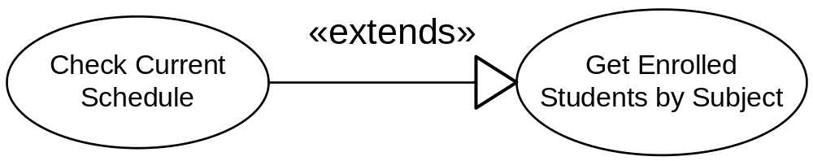
Use Case Diagrams
It is also possible to establish a relationship as a dependency between two use cases using the <<extends>> line
An <<extends>> line indicates that the use case is dependent on another use case in order to perform the functionality
Notes:
Solutions Engineering Fundamentals: Java
Course #Z16325
© 2009 Accenture All Rights Reserved.

Slide 9
Class Diagrams
Class diagrams are used to describe classes of objects in terms of their names, attributes, and operations
Class diagrams are used to describe the relationship of between objects in a system
Notes:
Solutions Engineering Fundamentals: Java
Course #Z16325
© 2009 Accenture All Rights Reserved.

Slide 10
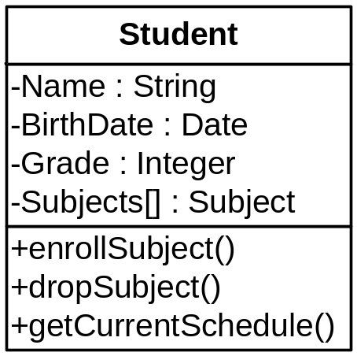
Class Diagrams
A Class diagram is composed of a class icon that defines the class itself
The class icon describes the name of the class, the attributes of a class, and the behaviors/operations of a class
Notes:
Solutions Engineering Fundamentals: Java
Course #Z16325
© 2009 Accenture All Rights Reserved.
Class diagrams can act as conceptual design for an actual Java class

Slide 11
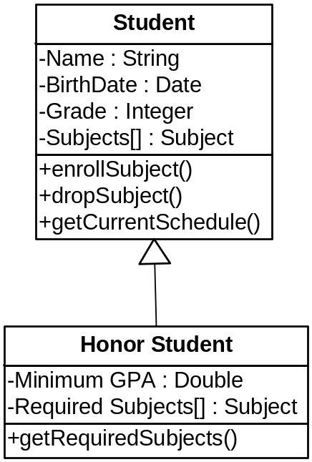
Class Diagrams
Class diagrams can denote inheritance relationships between two classes
The direction of the arrow points to the base or the parent class
Notes:
Solutions Engineering Fundamentals: Java
Course #Z16325
© 2009 Accenture All Rights Reserved.
Class diagrams can act as conceptual design for an actual Java class

Slide 12
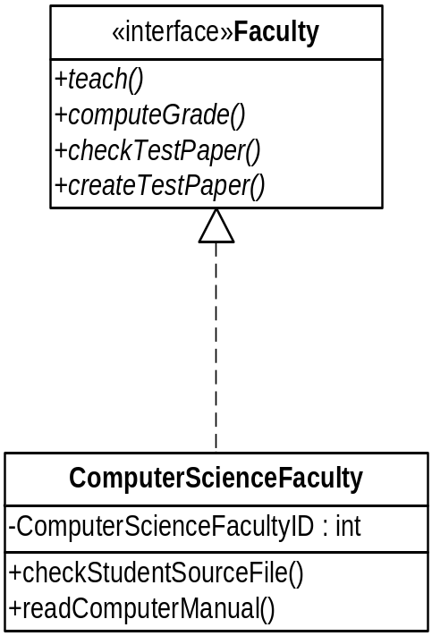
Class Diagrams
Class diagrams can denote implementation relationships between a class and an interface
The direction of the arrow points to the interface being implemented by the class
Notes:
Solutions Engineering Fundamentals: Java
Course #Z16325
© 2009 Accenture All Rights Reserved.
An interface defines a set of method and constant definitions but does not provide any implementation of those methods
An interface defines the “what” but not the “how”
A dashed line with an open arrow head shows the relationship between the implementing class and the interface

Slide 13
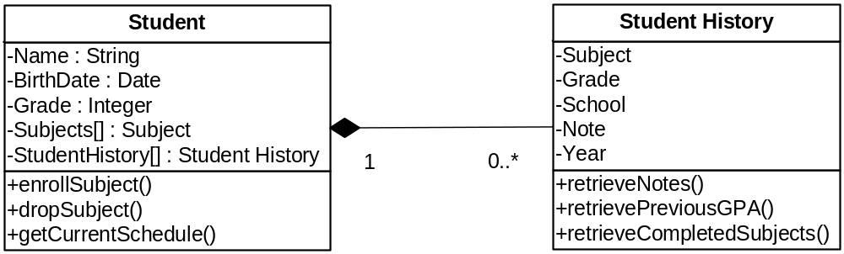
Class Diagrams
Class diagrams can be used to describe a ‘strong’ aggregation can be formed between two objects
This denotes a ‘has-a’ relationship between the two objects
The lifetime of the object that is contained is dependent on the lifetime of the container object
Notes:
Solutions Engineering Fundamentals: Java
Course #Z16325
© 2009 Accenture All Rights Reserved.
The example relationship means that a Student can have 0 or more Student History entries.
The strong relationship denote that a Student History object cannot exist without an associated Student object
The relationship also denotes that when a Student object is destroyed, all its corresponding Student History objects are also destroyed
This kind of relationship can express objects that are created when the container objects are also created. In terms of Java code, this might mean
A Student History can be an inner class of the Student Class
OR Student History objects cannot be instantiated using ‘new’ but are instead created using one of the methods of the Student class and destroyed when the Student History object is destroyed

Slide 14
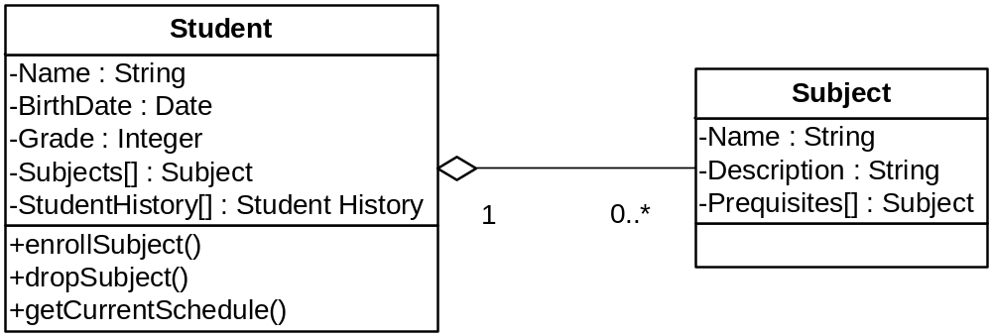
Class Diagrams
An ‘association’ relationship can be formed denoting a ‘weak’ aggregation between two objects
In an association relationship, the objects can exist independently of each other
Notes:
Solutions Engineering Fundamentals: Java
Course #Z16325
© 2009 Accenture All Rights Reserved.
The example relationship means that a Student can have 0 or more Subjects
Students and Subject can exist independently.
In code, objects with relationships like this are typically created independently from each other and are associated with each other by the container ‘setting’ the contained object
For example:
Student s = new Student();
Subject math101 = new Subject();
s.enrollSubject(math101);

Slide 15
Sequence Diagrams
Sequence diagrams show a group of objects interacting within a system to perform a specific functionality
Sequence diagrams show the ‘messages’ that are passed between one object to another, and the order (or sequence) that these messages are sent
Notes:
Solutions Engineering Fundamentals: Java
Course #Z16325
© 2009 Accenture All Rights Reserved.

Slide 16
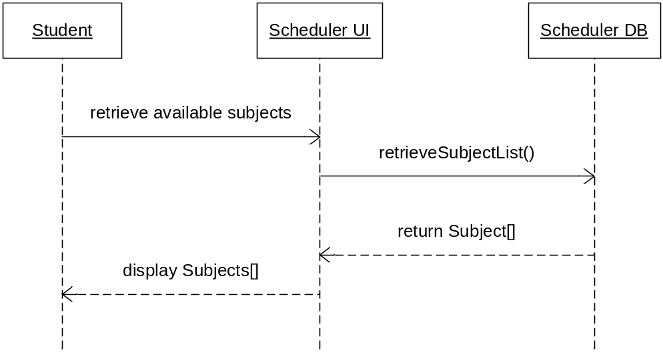
Sequence Diagrams
Messages are indicated as solid horizontal arrows attached to the timeline of the source object to the target object
Dashed horizontal arrows indicate the response of the message receiver
Notes:
Solutions Engineering Fundamentals: Java
Course #Z16325
© 2009 Accenture All Rights Reserved.

Slide 17
State Diagrams
State diagrams are used to model the changes in the state of an object as events occur.
The diagram represents what possible states an object can change into depending on its current state, and what events occur
Each diagram represents a objects of a single class
Notes:
Solutions Engineering Fundamentals: Java
Course #Z16325
© 2009 Accenture All Rights Reserved.

Slide 18

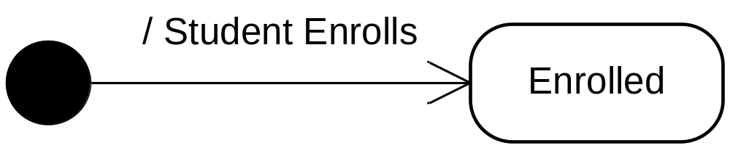
State Diagrams
State diagrams begin with an initial state:
Events or messages that cause the state to change is marked by an arrow pointing to an icon representing the resulting state
Notes:
Solutions Engineering Fundamentals: Java
Course #Z16325
© 2009 Accenture All Rights Reserved.

Slide 19
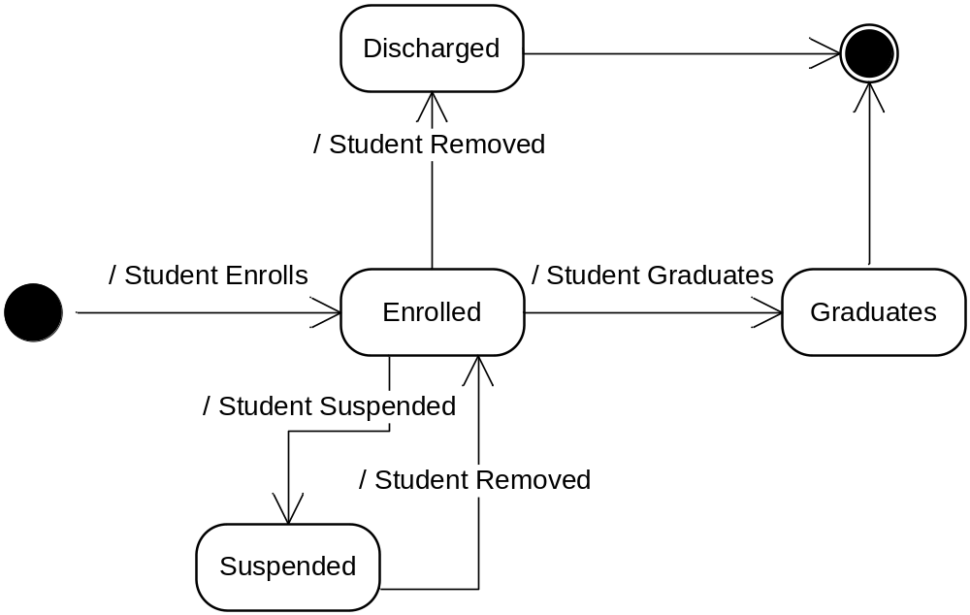
State Diagrams
The state can branch off to other states or itself depending on the messages or events it can receive.
Graduated
Notes:
Solutions Engineering Fundamentals: Java
Course #Z16325
© 2009 Accenture All Rights Reserved.

Slide 20
Questions and Comments
???
Notes:
Solutions Engineering Fundamentals: Java
Course #Z16325
© 2009 Accenture All Rights Reserved.

Slide 21
Module 17 Activity – Part I
Open your Microsoft Visio modeling application
Create a new UML Diagram by clicking on File → New → Software → UML Model Diagram
Create a Sequence Diagram given the following scenario and requirements:
A customer wants to order an item from a fast-food store via an online self-service kiosk system. To accomplish this, the customer inputs his order via the kiosk's touch screen user interface (UI). The UI logic will make calls to the order service layer to compute the total payment for the order. Once the customer approves the total cost of the order, the system will proceed to process the payment. The system will then input the order details into the order database and provide a notification to the customer.
  Base your Sequence Diagram on the above Online Ordering Kiosk System
  Classes used are Customer, OrderUI, OrderService, and OrderDB

Slide 22
Module 17 Activity – Part 2
Open your Microsoft Visio modeling application
Create a new UML Diagram by clicking on File → New → Software → UML Model Diagram
Create a State Diagram given the following scenario and requirements:
A customer orders an item from a fast-food counter. To accomplish this, the customer states his order to the cashier. Once he has ordered, the customer pays the cashier for the food item. The customer then receives the item ordered. If for some reason the order is cancelled after having paid for the item already, the customer is refunded.
Note:
  Focus ONLY on Customer State
  Show positive and negative scenarios i.e. Customer state is Ordered and Order Cancelled

Slide 23
Module 17 Activity – Part 3
Open your Microsoft Visio modeling application
Create a new UML Diagram by clicking on File → New → Software → UML Model Diagram
Create a Class Diagram for Point2D, Point2DImpl, Point3D and Point3DIMpl classes (From Module 6 Activity)
Create class diagram for Currency, CurrencyImpl, Denomination and DenominationImpl (From Module 7 Activity)

